Slide 1
Randomized Algorithms CS648
Lecture 21
Distributd Leader Election - II
Random walk and Electric Network – II

Slide 2


Leader Election in a complete network
Implicit
There are $n$ nodes.
Each node is connected to every other node.
Each node
knows $n$.
can send a message to its neighbours.
can do local computation.
A single node : “leader”
Every other node is a slave
Every node knows the leader
$$n=5$$
Find a leader

Slide 3
Leader Election in a complete network
Implicit
There are $n$ nodes.
Each node is connected to every other node.
Each node
knows $n$.
can send a message to its neighbours.
can do local computation.
A single node : “leader”
Every other node is a slave
Only leader knows that he/she is leader
$$n=5$$
Find a leader

Slide 4










$$T$$
$$T$$
$$H$$
$$T$$
$$H$$
$$T$$
$$H$$
$$T$$
$$T$$
$$T$$

Slide 5















$$T$$
$$T$$
$$18832908$$
$$H$$
$$T$$
. . . .
$$H$$
$$89013782$$
$$T$$
$$T$$
$$H$$
$$38127428$$
$$T$$
$$T$$

Slide 6
. . . .

Slide 7

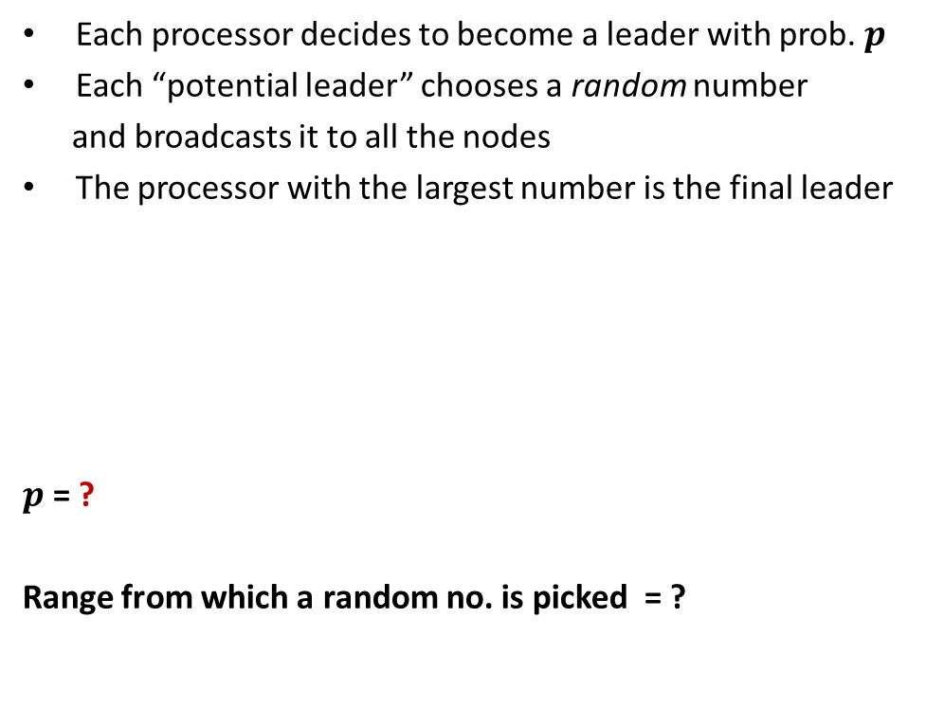
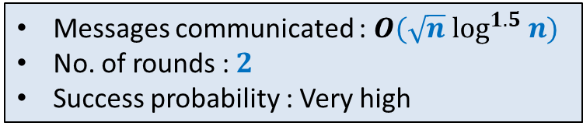
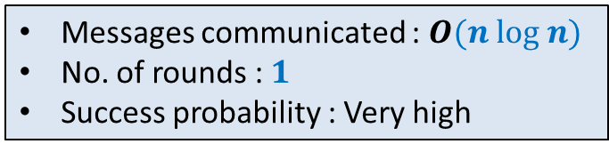

Each processor decides to become a leader with prob. $p$
Each “potential leader” chooses a random number
and broadcasts it to all the nodes
The processor with the largest number is the final leader
$p$ = ?
Range from which a random no. is picked = ?
$$\frac{3\left(log n\right)}{n}$$
$$[1,n^{4}]$$
Messages communicated : $O(\sqrt{n} \log^{1.5} n)$
No. of rounds : $2$
Success probability : Very high
Messages communicated : $O(n log n)$
No. of rounds : $1$
Success probability : Very high

Slide 8
$$T$$
$$T$$
$$H$$
$$T$$
$$H$$
$$T$$
$$H$$
$$T$$
$$T$$
$$T$$

Slide 9
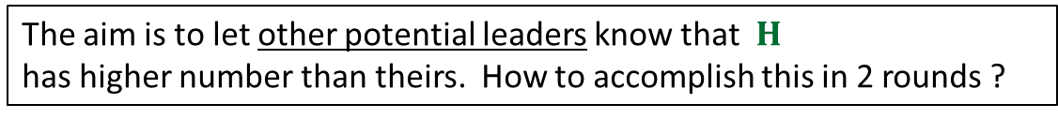

$$T$$
$$T$$
$$18832908$$
$$H$$
$$T$$
$$H$$
$$89013782$$
$$T$$
$$T$$
$$H$$
$$38127428$$
$$T$$
$$T$$
The aim is to let other potential leaders know that $H$
has higher number than theirs. How to accomplish this in 2 rounds ?

Slide 10




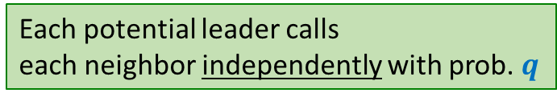
Each potential leader calls
each neighbor independently with prob. $q$
Probability of no common neighbor =
$${\left(1−q^{2}\right)}^{n}$$
$$≈1/n^{4}$$
$$2\sqrt{\frac{log n}{n}}$$
$$q= ?$$

Slide 11
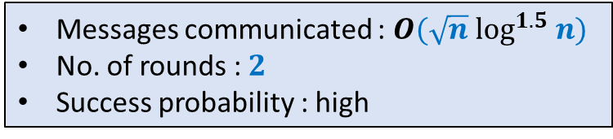
Each potential leader calls
each neighbor independently with prob. $q$
Messages communicated : $O(\sqrt{n} \log^{1.5} n)$
No. of rounds : $2$
Success probability : high

Slide 12
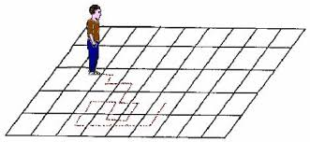
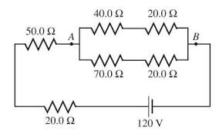
Random walk
Electric networks
A. K. Chandra, P. Raghavan, W. L. Ruzzo, R. Smolensky, P. Tiwari: The Electrical Resistance of a Graph Captures its Commute and Cover Times
(Detailed Abstract). STOC1989: 574-586

Slide 13







Electric Potential is conservative
$$b$$
$$y$$
Question: What is $V_{yu}$ ?
Answer:
$V_{yu}=V_{yx}+V_{xa}+V_{au}$
$=V_{yz}+V_{za}+V_{au}$
FACT: $V_{yu}$ is path independent.
$$u$$
$$x$$
$$a$$
$$z$$

Slide 14
Basic laws of Electric networks
Electric Potential is conservative
Ohm’s law
Kirchoff’s law

Slide 15












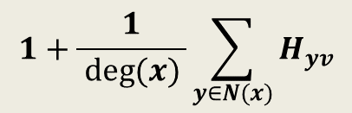
Expressing $H_{xv}$ through equations
$$y$$
$$b$$
$H_{xv}=$ ?
$$c$$
$$v$$
$$x$$
$$u$$
$$g$$
$$d$$
$$a$$
$$z$$
$$1+\frac{1}{ deg(x) }\sum_{y∈N(x)}{H_{yv}}$$

Slide 16

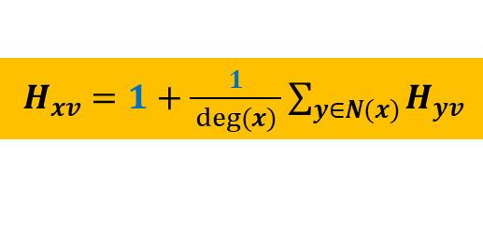



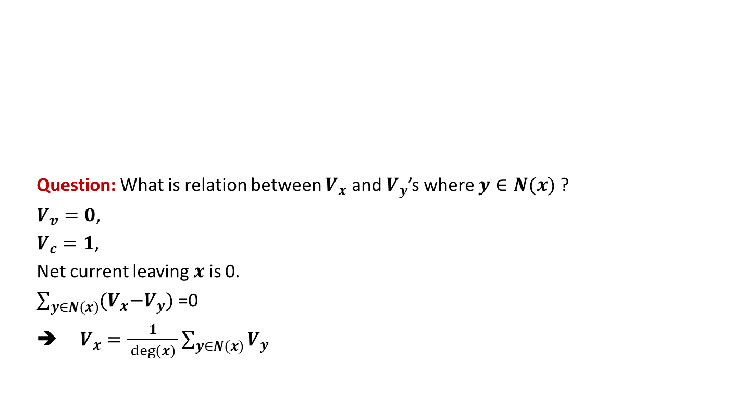


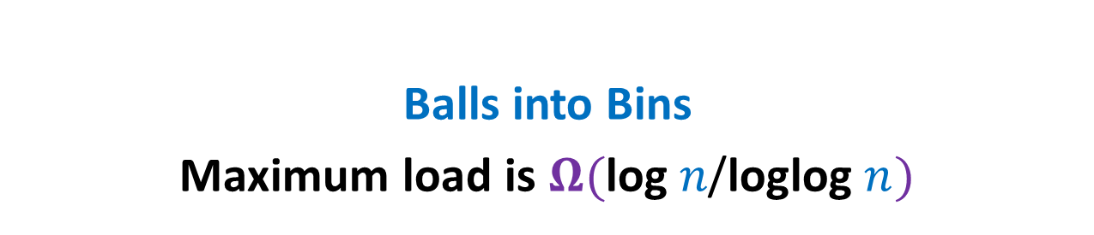



Doyle and Snell’s article
1 volt
$$y$$
$$b$$
Question: What is relation between $V_{x}$ and $V_{y}$’s where $y∈N(x)$ ?
$V_{v}=0$,
$V_{c}=1$,
Net current leaving $x$is 0.
$\sum_{y∈N(x)}{{(V}_{x}−V_{y}) \text{=0}}$
➔ $V_{x}=\frac{1}{ deg(x) }\sum_{y∈N(x)}{V_{y}}$
$$c$$
$$v$$
$$x$$
$$u$$
$$g$$
$$d$$
$$a$$
$$z$$
$H_{xv}=1+\frac{1}{ deg(x) }\sum_{y∈N(x)}{H_{yv}}$

Slide 17




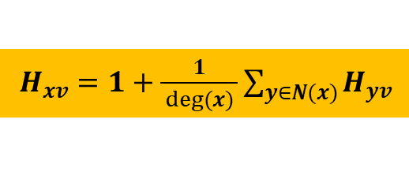
Expressing $H_{xv}$ through a circuit
$$y$$
$$b$$
Let $I_{x}$ be the current injected into $x$ from outside.
Question: What is the new relation between $V_{xv}$ and $V_{yv}$’s where $y∈N(x)$ ?
$V_{xv}=\frac{I_{x}}{deg(x)}+\frac{1}{ deg(x) }\sum_{y∈N(x)}{V_{yv}}$
➔ We must extract $2m−deg(v)$ current from $v$ to satisfy Kirchoff’s current law.
$$c$$
$$v$$
$$x$$
$$u$$
$$g$$
$$d$$
$$a$$
$$z$$
$H_{xv}=1+\frac{1}{ deg(x) }\sum_{y∈N(x)}{H_{yv}}$
$$I_{x}=deg(x)$$
Is such a current flow possible ?

Slide 18
REvisiting Theory of electric circuits

Slide 19







Effective resistance between two points
The effective resistance between $a$ and $b$ is $3.33Ω$ ?
$$1Ω$$
$$1Ω$$
$$2Ω$$
$$a$$
$$b$$
$$2Ω$$
$$2Ω$$

Slide 20
Three simple principles
Fully understand these principles so that you may apply them later on.

Slide 21
Three simple principles

Slide 22
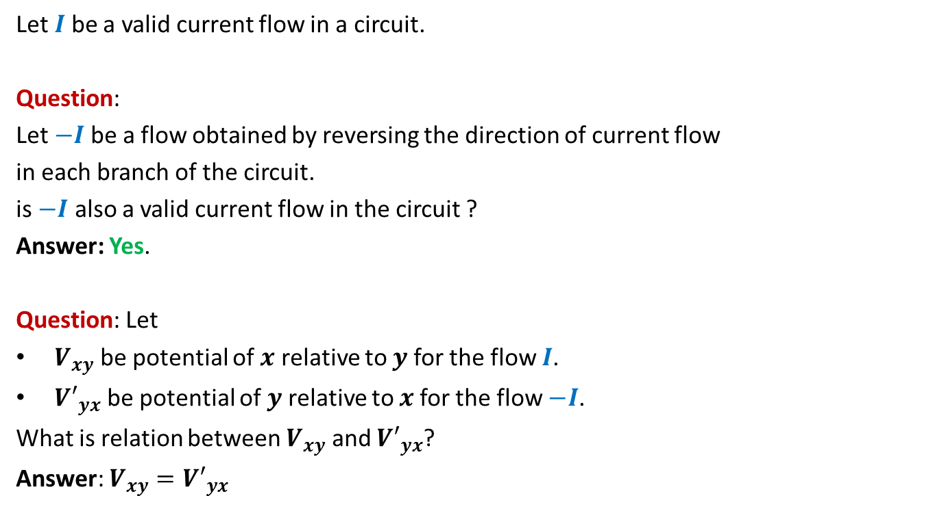
Reversibility
Let $I$ be a valid current flow in a circuit.
Question:
Let $−I$be a flow obtained by reversing the direction of current flow
in each branch of the circuit.
is $−I$ also a valid current flow in the circuit ?
Answer: Yes.
Question: Let
$V_{xy}$ be potential of $x$ relative to $y$for the flow $I$.
${V′}_{yx}$ be potential of $y$ relative to $x$for the flow $−I$.
What is relation between $V_{xy}$ and ${V′}_{yx}$?
Answer: $V_{xy}={V′}_{yx}$

Slide 23
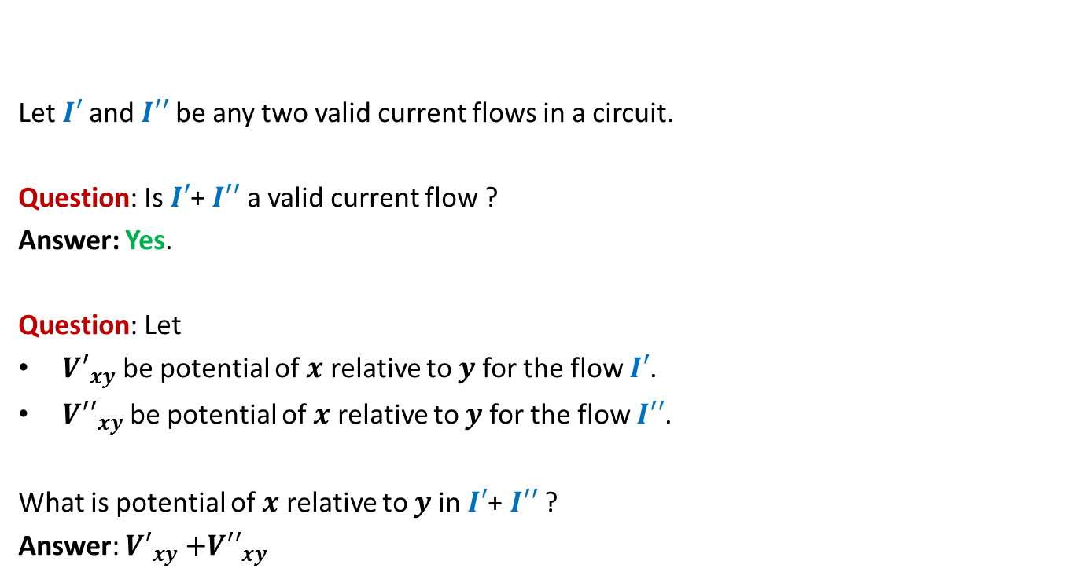
Linearity of current flow
Let $I′$and $I′′$be any two valid current flows in a circuit.
Question: Is $I′$+ $I′′$ a valid current flow ?
Answer: Yes.
Question: Let
${V′}_{xy}$ be potential of $x$ relative to $y$for the flow $I′$.
${V′′}_{xy}$ be potential of $x$ relative to $y$for the flow $I′′$.
What is potential of $x$ relative to $y$in $I′$+ $I′′$ ?
Answer: ${V′}_{xy}{+V′′}_{xy}$

Slide 24

Uniqueness
5V
$$b$$
$$y$$
25V
If we assign any arbitrary potential to nodes in a circuit,
there exists a unique and valid current flow in the circuit satisfying these potentials.
However, note that, this will require that you connect external wires to allow residual current to enter/leave a node to satisfy Kirchoff’s law.
Interestingly the converse of the above rule is also true ☺.
15V
2V
$$u$$
$$x$$
$$a$$
$$z$$
22V
30V

Slide 25
Uniqueness
$$b$$
$$y$$
15 A
Is it possible to inject and extract any arbitrary amount of current into nodes of a circuit from outside ?
Yes, there will be a unique and valid current flow satisfying the current from/to the nodes provided that the current satisfies Kirchoff’s law (net current into circuit is 0).
Basically the current distributes itself within the circuit to give a unique and valid assignment of potentials to all nodes.
5 A
$$u$$
$$x$$
2 A
15 A
10 A
$$a$$
$$z$$
3 A
The reason behind this uniqueness principle lies in the fact that
there is a set of linear equations for each circuit on the basis of
Kirchoff’s law and Ohm’s law. These equations have a unique solution.
Interested students might like to explore this fact. But for this course,
it is fine if you just understand this principle of uniqueness.

Slide 26
Uniqueness
$$b$$
$$y$$
15 A
Is it possible to inject and extract any arbitrary amount of current into nodes of a circuit from outside ?
Yes, there will be a unique and valid current flow satisfying the current from/to the nodes provided that the current satisfies Kirchoff’s law (net current into circuit is 0).
Basically the current distributes itself within the circuit to give a unique and valid assignment of potentials to all nodes.
5 A
$$u$$
$$x$$
2 A
15 A
10 A
$$a$$
$$z$$
3 A
The usefulness of this principle is that we can assign
any arbitrary current into or out of each node
(ensuring net current in the circuit is zero) based on requirement
and it will result in a valid current satisfying all the current laws.

Slide 27
Uniqueness
$$b$$
$$y$$
15 A
5 A
$$u$$
$$x$$
2 A
15 A
10 A
$$a$$
$$z$$
3 A

Slide 28
Random walk and electric networks

Slide 29


Expressing $H_{xv}$ through a circuit
$$y$$
$$b$$
$V_{xv}=\frac{I_{x}}{deg(x)}+\frac{1}{ deg(x) }\sum_{y∈N(x)}{V_{yv}}$
➔ Extract $2m−deg(v)$ current from $v$.
$$c$$
$$v$$
$$x$$
$$u$$
$$g$$
$$d$$
$$a$$
$$z$$
$H_{xv}=1+\frac{1}{ deg(x) }\sum_{y∈N(x)}{H_{yv}}$
$$I_{x}=deg(x)$$
Apply principle of Uniqueness
This is a valid current flow $I$

Slide 30


Expressing $H_{xu}$ through a circuit
$$y$$
$$b$$
$H_{xu}$ is the potential of $x$relative to $u$ in circuit
with the following current flow $I′$:
Inject $deg(x)$ current into each $x∈V\backslash \{u\}$,
Extract $2m−deg(u)$ current from $u$.
$$c$$
$$v$$
$$x$$
$$u$$
$$g$$
$$d$$
$$a$$
$$z$$

Slide 31


$H_{uv}$ + $H_{vu}$= ??
$$y$$
$$b$$
$H_{uv}=V_{uv}$ in circuit($G$) with current flow $I$.
$H_{vu}=V_{vu}$ in circuit($G$) with current flow $I′$.
$$c$$
$$v$$
$$x$$
$$u$$
$$g$$
$$d$$
$$a$$
$$z$$
$$y$$
$$b$$
$$c$$
$$v$$
$$x$$
$$u$$
$$g$$
$$d$$
$$a$$
$$z$$
Apply principle of Reversibility

Slide 32
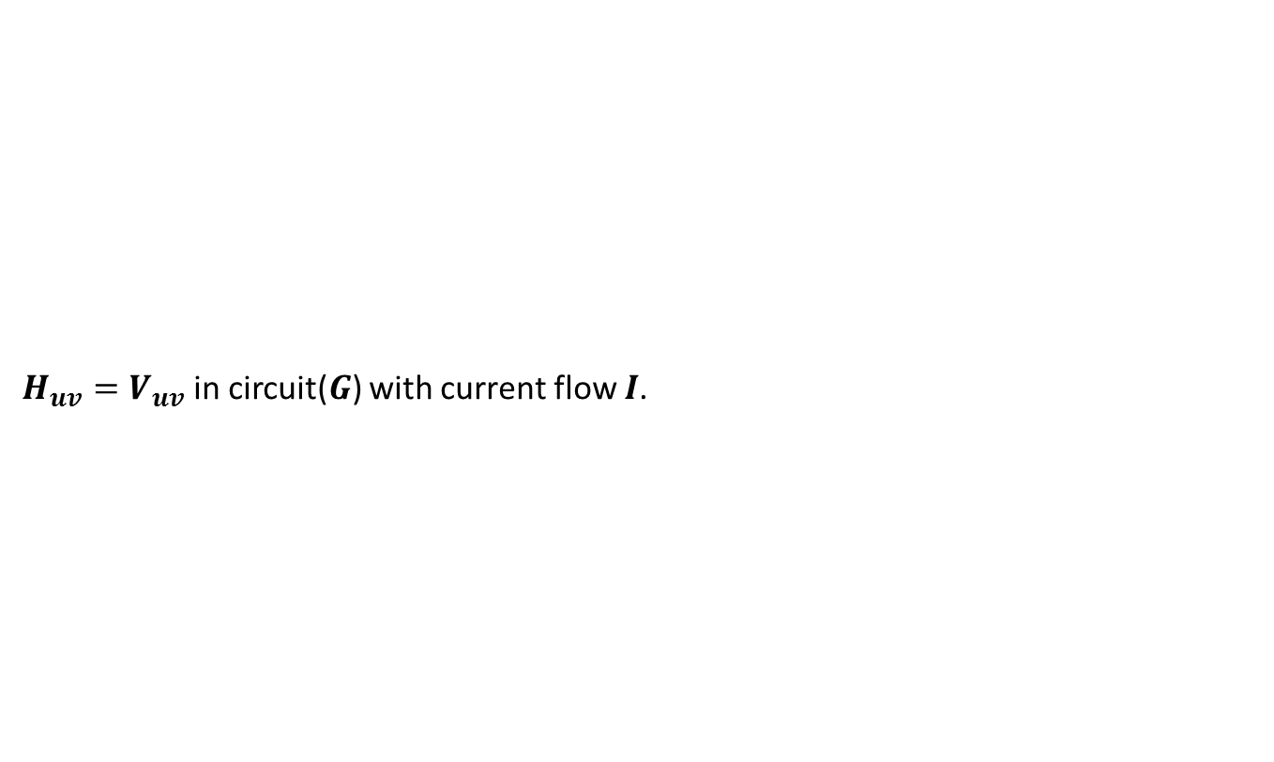




$H_{uv}$ + $H_{vu}$= ??
$$y$$
$$b$$
$H_{uv}=V_{uv}$ in circuit($G$) with current flow $I$.
$$c$$
$$v$$
$$x$$
$$u$$
$$g$$
$$d$$
$$a$$
$$z$$
Apply principle of Linearity
$$y$$
$$b$$
$$c$$
$$v$$
$$x$$
$$u$$
$$g$$
$$d$$
$$a$$
$$z$$
$H_{vu}=$
$V_{uv}$ in circuit($G$) with current flow $−I′$.
${−V}_{vu}$ in circuit($G$) with current flow $−I′$.

Slide 33

$H_{uv}$ + $H_{vu}$= ??
$H_{uv}+H_{vu}$
${=V}_{uv}$ in circuit($G$) with current flow $I−I′$.
$$y$$
$$b$$
$$c$$
$$v$$
$$x$$
$$u$$
$$g$$
$$d$$
$$a$$
$$z$$

Slide 34
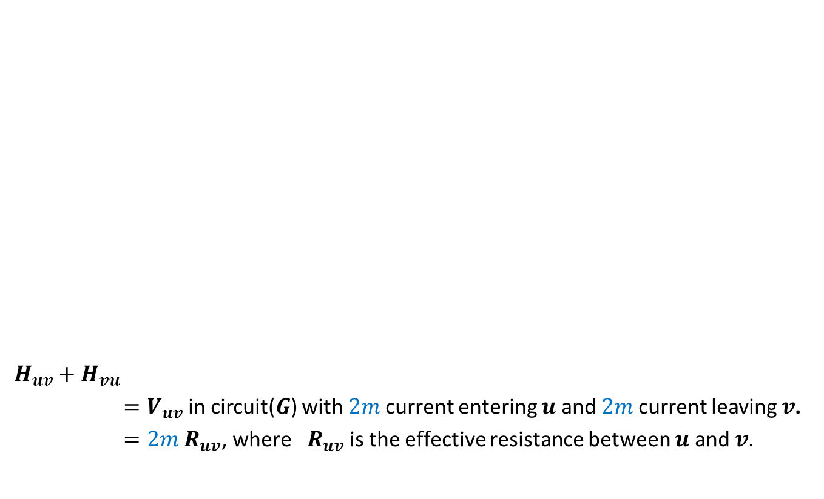


$H_{uv}$ + $H_{vu}$= ??
$H_{uv}+H_{vu}$
${=V}_{uv}$ in circuit($G$) with $2m$current entering $u$ and $2m$current leaving $v$.
$=2m{ R}_{uv}$, where ${ R}_{uv}$ is the effective resistance between $u$ and $v$.
$$y$$
$$b$$
$$c$$
$$v$$
$$x$$
$$u$$
$$g$$
$$d$$
$$a$$
$$2m$$
$$2m$$
$$z$$

Slide 35
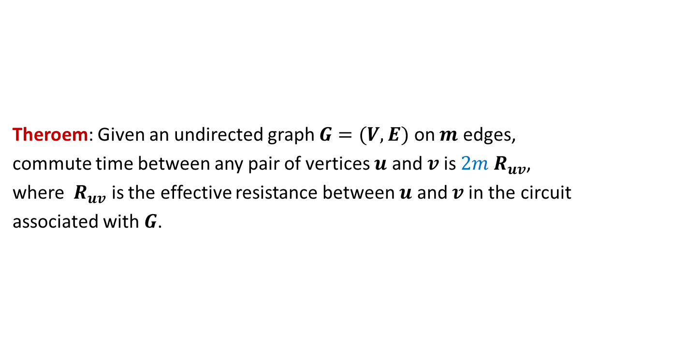
Theroem: Given an undirected graph $G=(V,E)$ on $m$ edges,
commute time between any pair of vertices $u$ and $v$is $2m{ R}_{uv}$,
where ${ R}_{uv}$ is the effective resistance between $u$ and $v$in the circuit
associated with $G$.

Slide 36
Commute Time of some well studied graphs

Slide 37
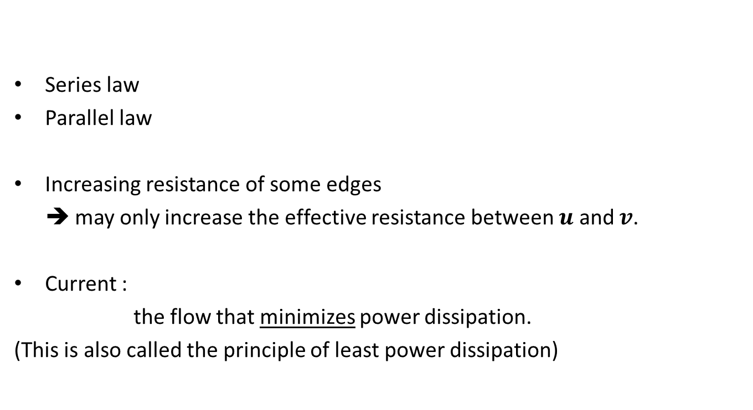
Useful tips from theory of electric networks
Series law
Parallel law
Increasing resistance of some edges
➔ may only increase the effective resistance between $u$ and $v$.
Current :
the flow that minimizes power dissipation.
(This is also called the principle of least power dissipation)

Slide 38



A complete graph
Let $G$ be a complete graphs on $n$ vertices.
What is the maximum commute time in this graph ?
$$2(n−1)$$
$$n=5$$

Slide 39



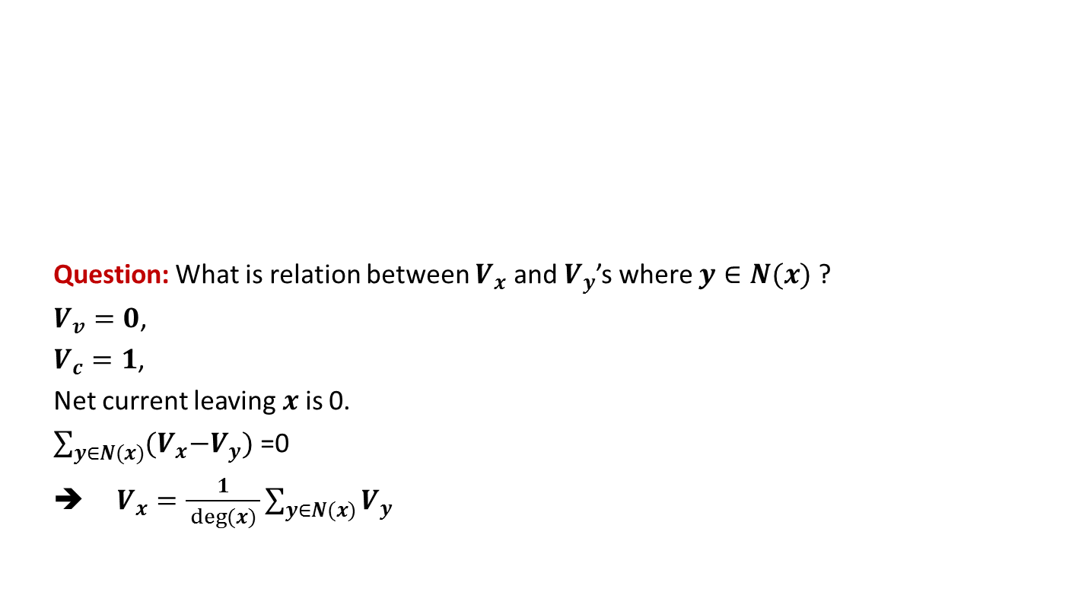
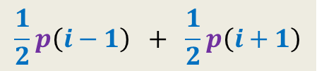

Two complete graphs joined by an edge
Let $G$ and $H$ be two complete graphs on $n$ vertices.
We add an edge between a vertex in $G$ and a vertex in $H$.
What is the maximum commute time in this combined graph ?
$$x$$
$$y$$
$$u$$
$$v$$
$$2(n\left(n−1\right)+1)(1+4/n)$$
Using knowledge of resistances, do it as a homework

Slide 40

A $n×n$ grid graph
Using principle of least power dissipation, find commute time

